Slide 1
ML2 2.2
Complex Machine Learning Model
Keras and RNN
By: Jordan Novelli

Slide 2
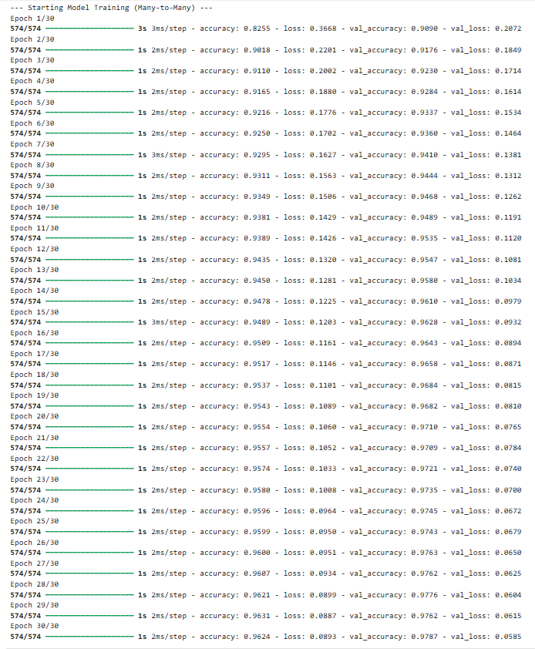
RNN #1
Epoch: 30
Batch size: 32
Hidden layers:32
Verbose: 1
Activation function: sigmoid
Loss: 0.3668 → 0.0893
Accuracy: 0.8255 → 0.9624
Note: There is great evidence of if loss improvement and accuracy improvement!

Slide 3
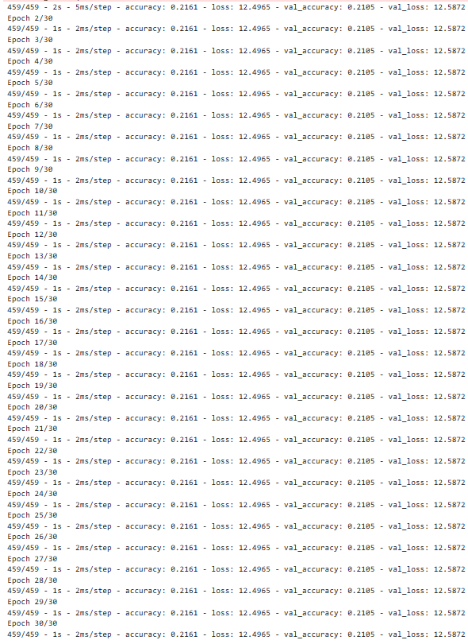
RNN #2
Epoch: 30
Batch size: 40
Hidden layers: 38
Verbose: 2
Activation function: softmax
Loss: 12.4965 → 12.4695
Accuracy: 0.2161 → 0.2161
Note: I assume the softmax prevented the improvement of the loss and accuracy.

Slide 4
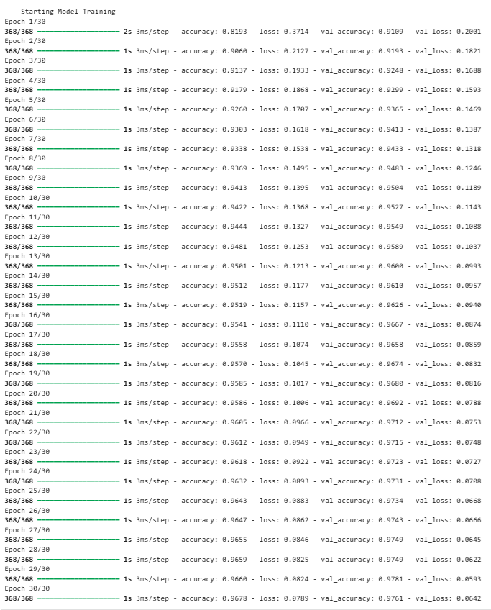
RNN #3
Epoch: 30
Batch size: 50
Hidden layers: 44
Verbose: 1
Activation function: sigmoid
Loss: 0.3714 → 0.0789
Accuracy: 0.8193 → 0.9678
Note: This is a slight amount of approvement from RNN #1.

Slide 5
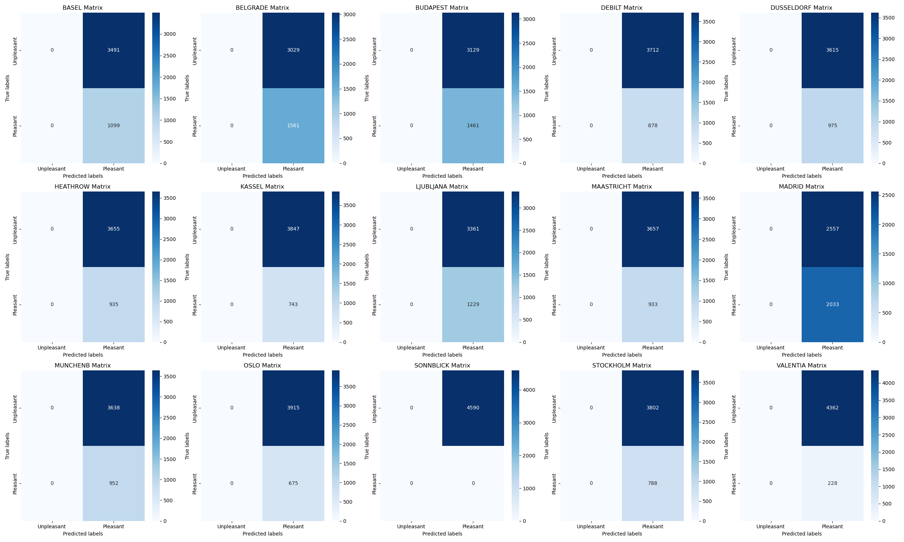
Confusion Matrix
This multi-confusion matrix doesn’t provide great insight. It reads as though there are low amount of pleasant weather days and more undefined days that are neither pleasant nor unpleasant. However, the only other option for this is unpleasant since there are only 0s and 1s in the pleasant weather data set.

Slide 6
END

